Slide 1
Citi Bike Analytics
This analysis is based on data is from February 2018 to January 2020

Slide 2
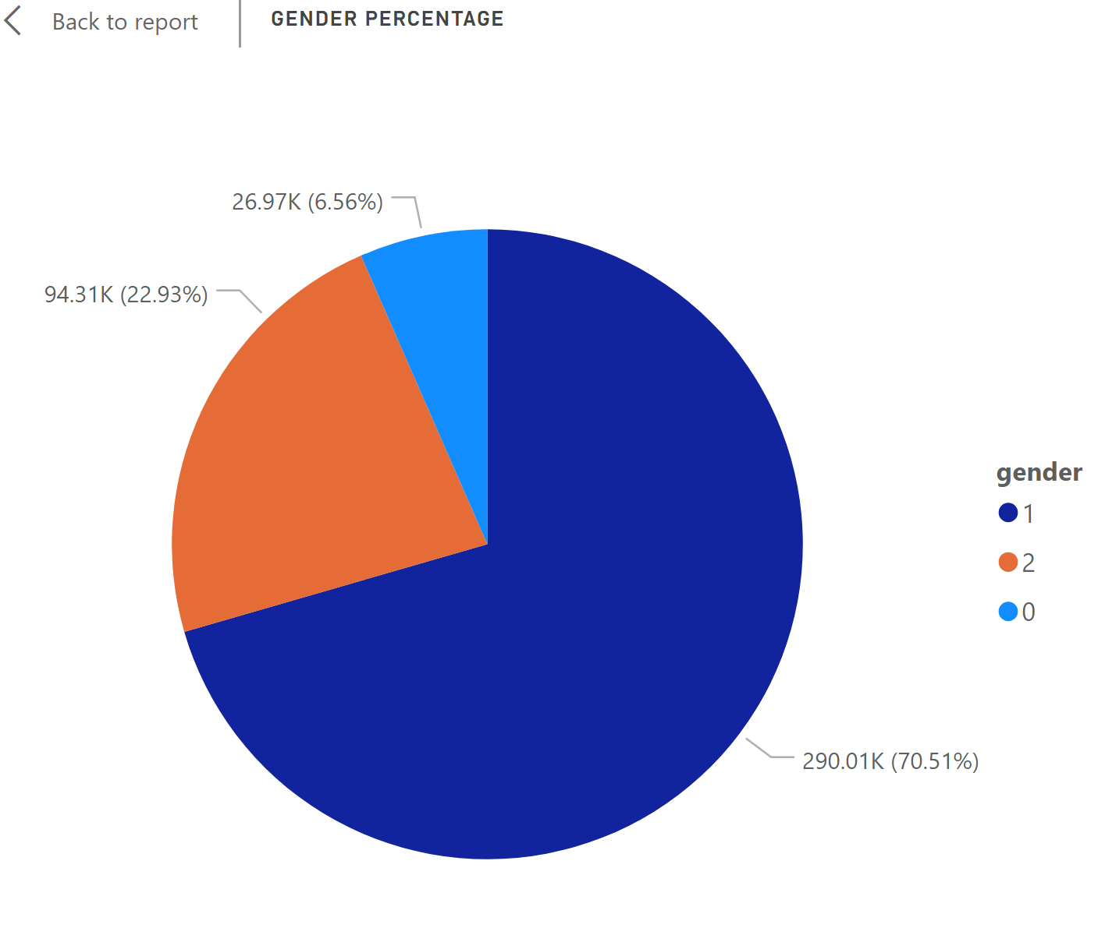
gender breakdown of active participants
0=unknown; 1=male; 2=female;
Male users are more than 70% of the total user especially when considering they are 6.56% unknown users.
Actions: if Citi Bike want to make advertisement on bike/mobile app to make profits, the targeted customer should be male users.

Slide 3
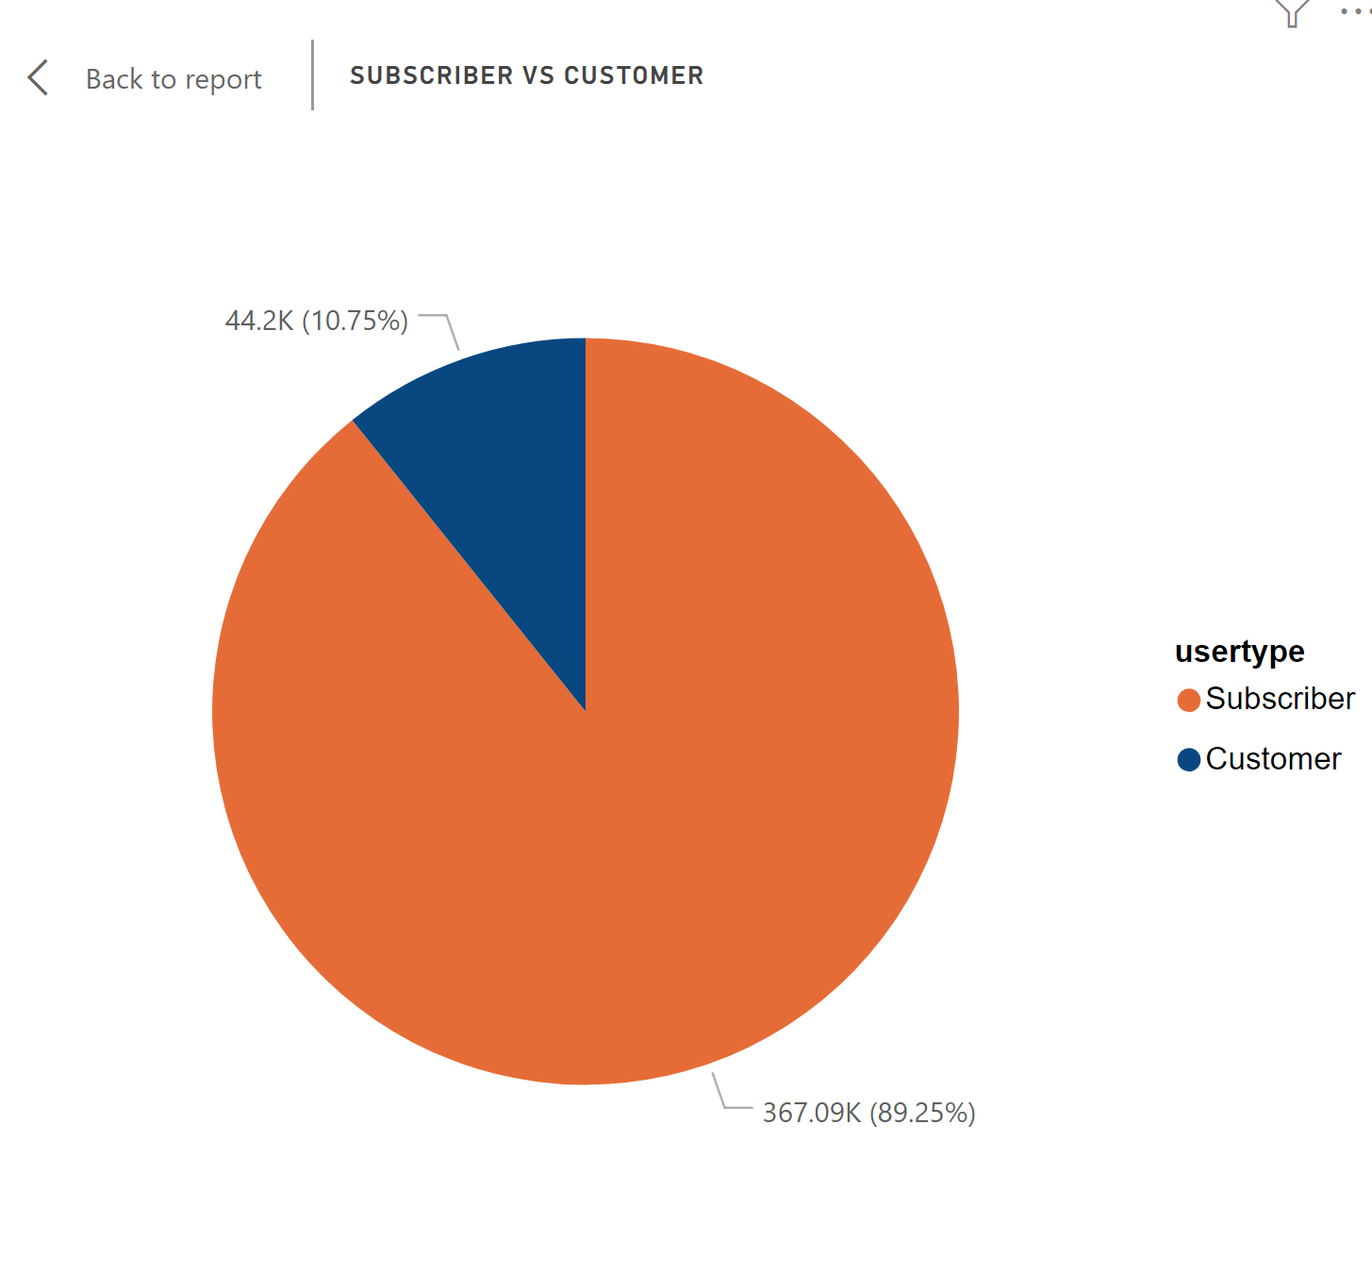
Subscriber vs customer
About 90% of users are subscribers
It indicates that this product(Citi Bike) has poor attraction for new users or the stickiness of user is high

Slide 4
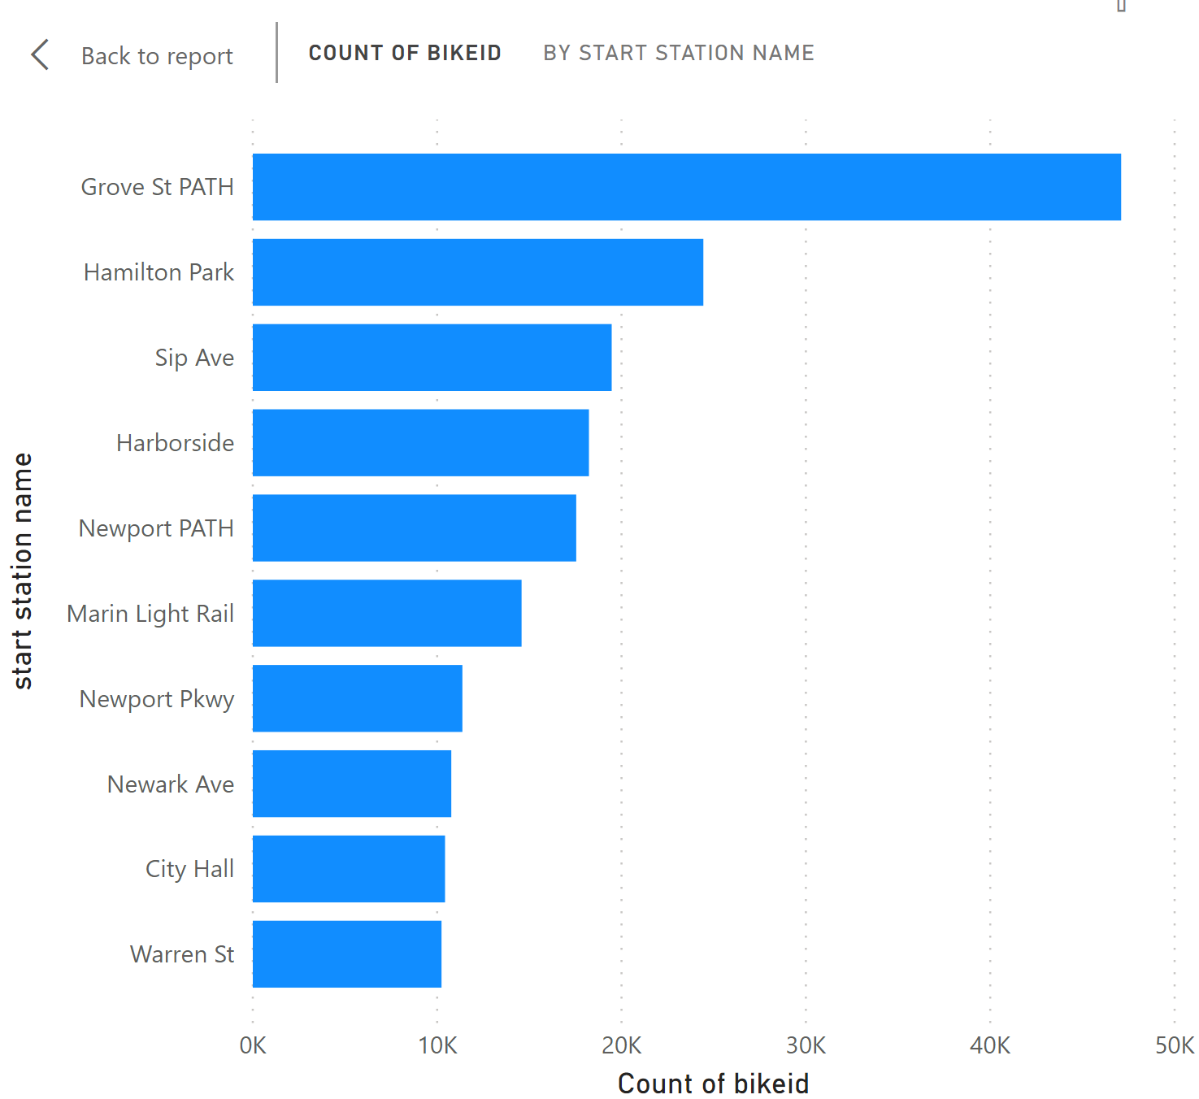
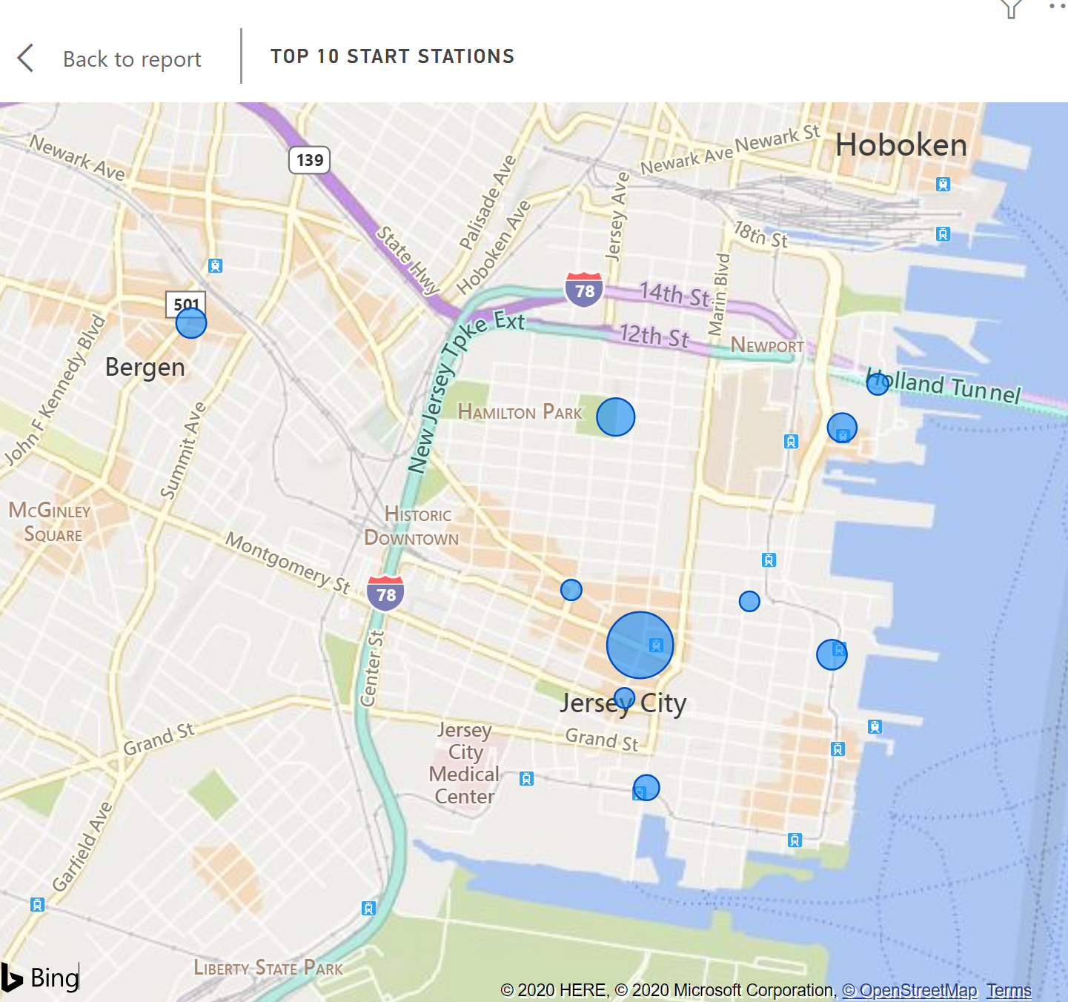
the top 10 stations in the city for starting a journey

Slide 5
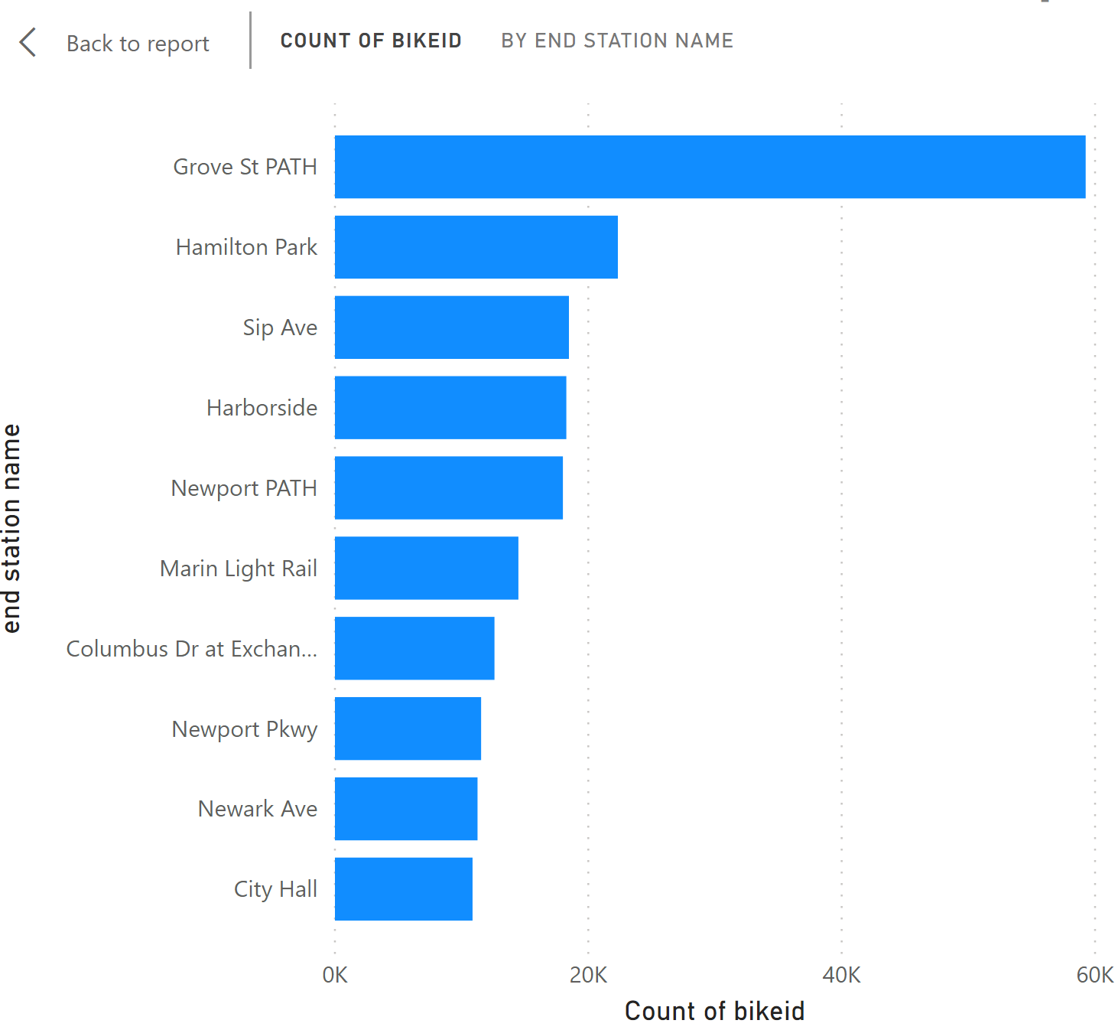
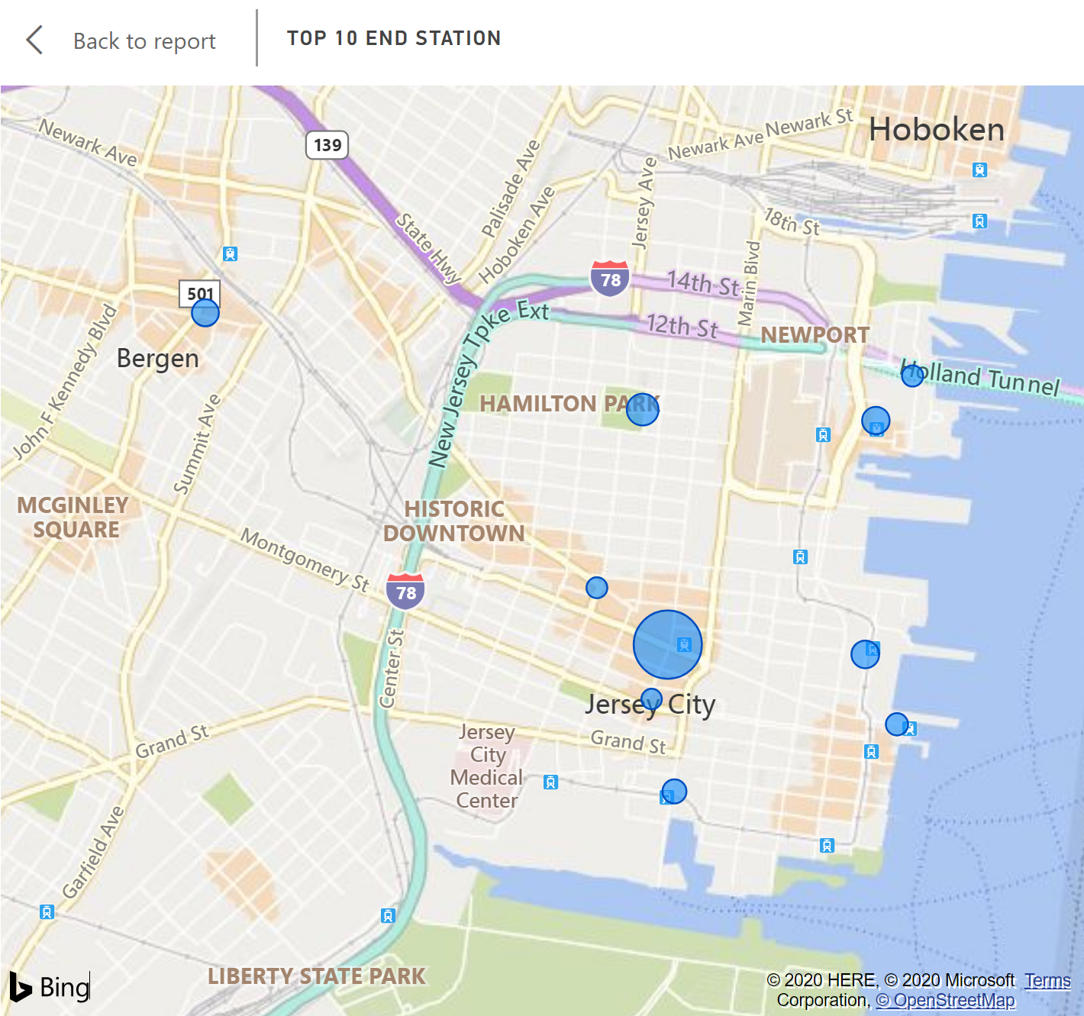
the top 10 stations in the city for Ending a journey
Top 10 starting stations and top 10 ending station have similar pattern, besides the rank 7th to 10th
Grove St Path always have significantly more amount of user traffic than other stations

Slide 6
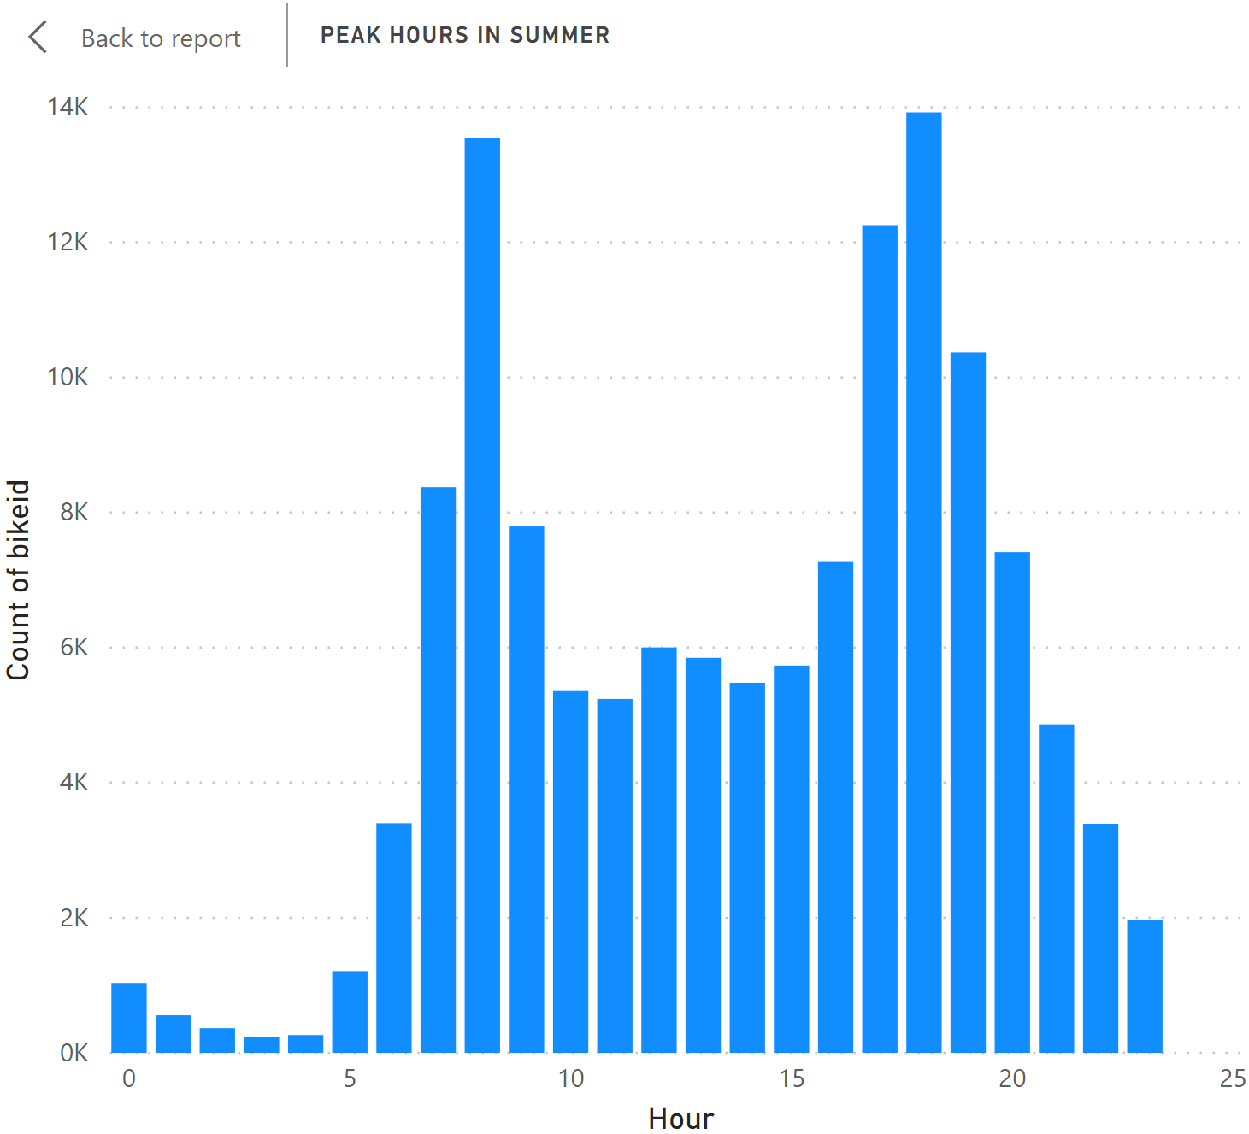
Summer hour
Two peak hours in the summer are 8AM and 6PM
There are close to 14k active users at 6PM.

Slide 7
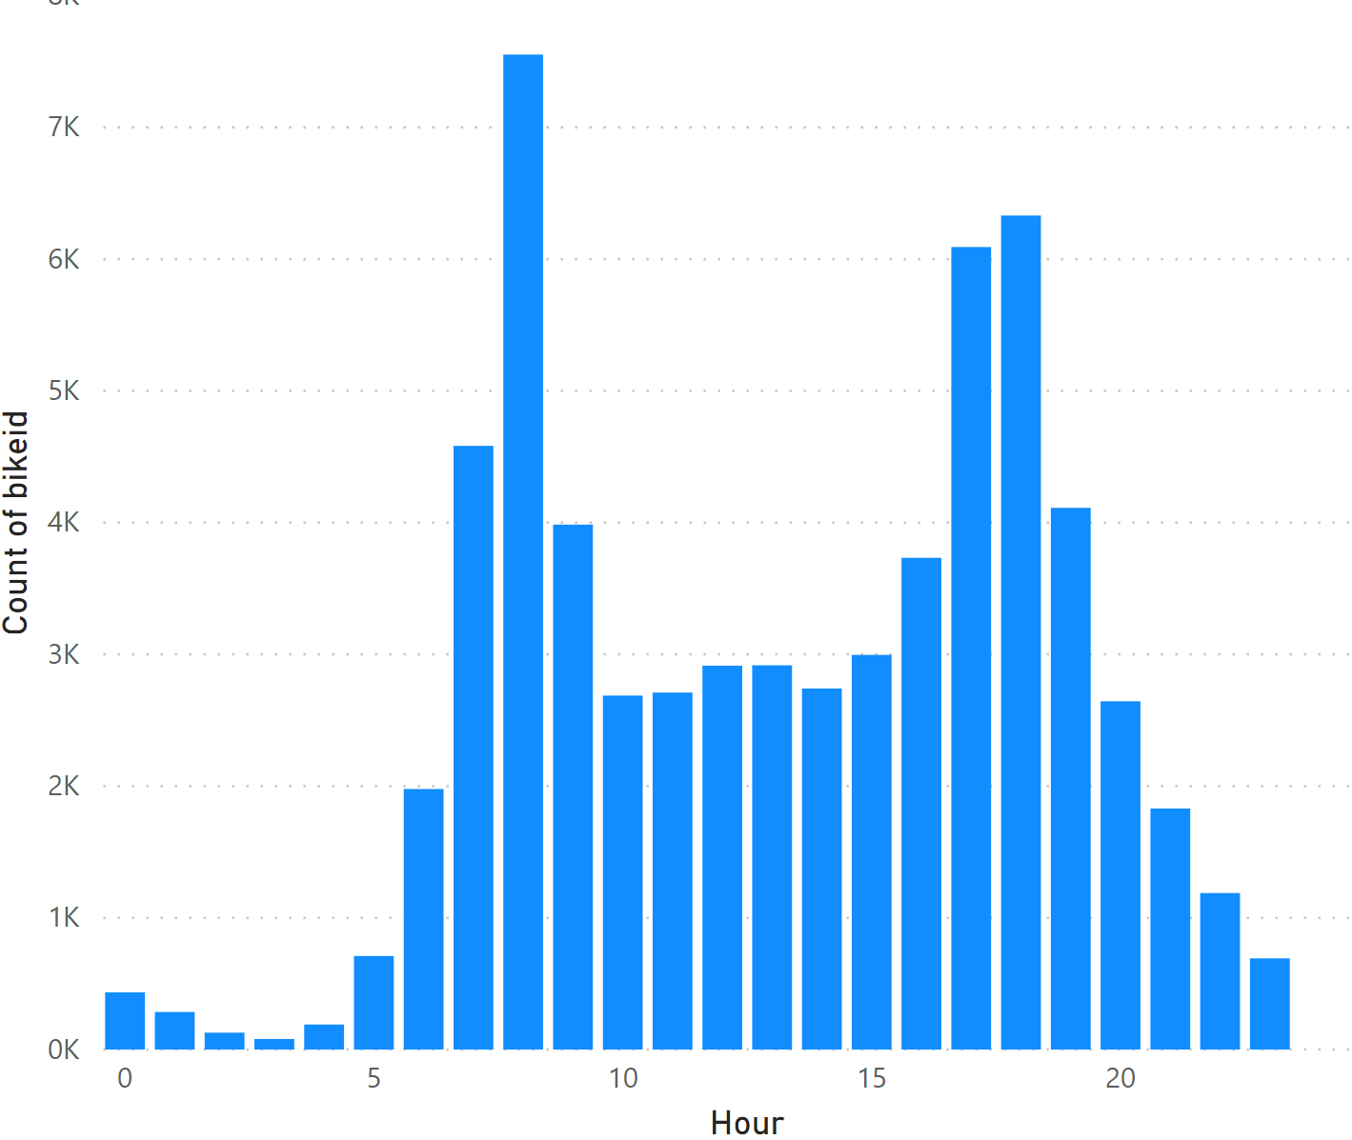
Winter Hour
Two peak hours in the summer are 8AM and 6PM, which are same with summer hours
However, the user amount decreased dramatically during winter, which is reasonable due to winter condition in JC.

Slide 8
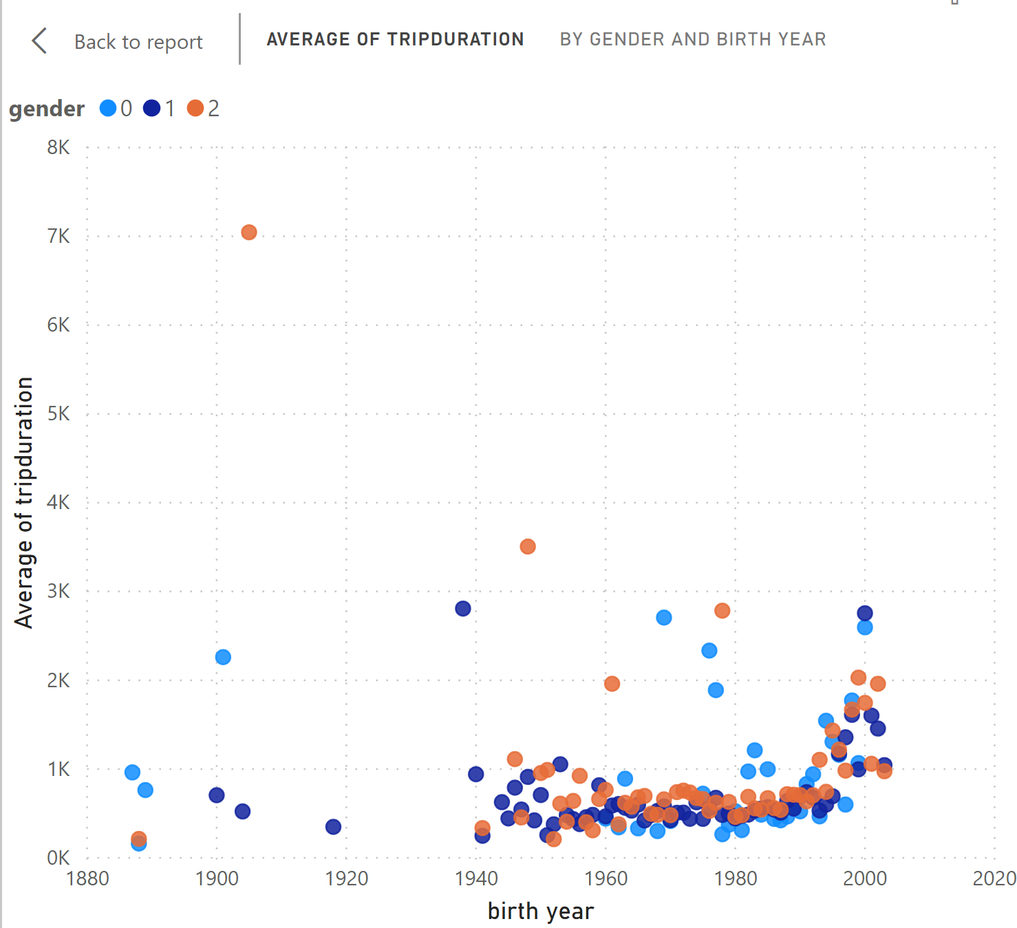
Average trip duration
Younger people trend to ride for longer distance, except few outliers
Average trip distance among genders does not diverge by much

